Slide 1
Git’n Pro with HTML/CSS

Slide 2
It’s Okay!
How do I do this again?
Flickr: welcometolearn

Slide 3
Admin Items

Slide 4
Where to Get Help
Practice, Practice, Practice: Work Individually or in Groups
Review In Class Material (Exercises and Slides): Gitlab
Re-Watch Class Videos: Here
In Class Office Hours: 45 minutes before class, 30 minutes after
One-on-One Sessions: By Announcement through SSM
Contact Student Success: Anytime!

Slide 5
Homework #1 - Assignment
Also, at this point everyone should have access to the class content and homework repository. Columbia Gitlab
Homework Assignment #1 is due next week
Next Saturday (June 16, 2018)
Note: BCS may have the wrong date

Slide 6
Today’s Class!

Slide 7
Today’s Objectives
Students will understand the importance of Git Version Control and of how to use it.
Students will create GitHub Repositories, push code into them, and share with class.
Students will make more HTML documents.
Students will learn to properly use basic HTML tags.
Students will implement basic CSS styling to HTML documents.

Slide 8
Know Thyself
If you are a complete beginner to HTML/CSS and Coding:
Continue getting comfortable with HTML.
Be able to completely write a basic HTML document (like in last class).
Understand what CSS is, what it’s for, and how it works with HTML.
Be able to use Git and GitHub to upload code.
If you’ve had past exposure and felt comfortable with the last lesson:
Aim to build up your skills. Clear up any questions or confusions about HTML.
Become knowledgeable about a wider range of HTML and CSS tags.
Be able to selectively apply CSS to specific HTML elements.
Be able to use Git and GitHub to upload code.

Slide 9
Hello, HTML (continued)
Notes:
Now that you can create HTML files from the terminal, let’s create one and actually write some HTML.

Slide 10
> YOUR TURN
Assignment:
In a new HTML file, create the basic structure of an HTML document and include the following in it:
DOCTYPE declaration.
Head tag with a title tag.
H1 tag with a title of your choice.
Embed an image.
Create the following three links on your page:
One link that is target="_blank" so that it opens a new tab when clicked on.
Make the second link bold.
Make the third link a placeholder so it goes nowhere.
Bonus:
Create an ordered list of steps to make a sandwich.
Create an unordered list of 5 bands/musicians you like.
Create a table with 2 columns (animal class and animal name) and 4 rows of animals.
Use an alternate way of separating links without line breaks.
Embed a YouTube video of your favorite band/musician.

Slide 11

YouTube Video Walkthrough!
https://www.youtube.com/watch?v=ieb6Svbc10E&index=1&list=PLgJ8UgkiorCnMLsUevoQRxH8t9bt7ne14

Slide 12
What / Why Git?

Slide 13
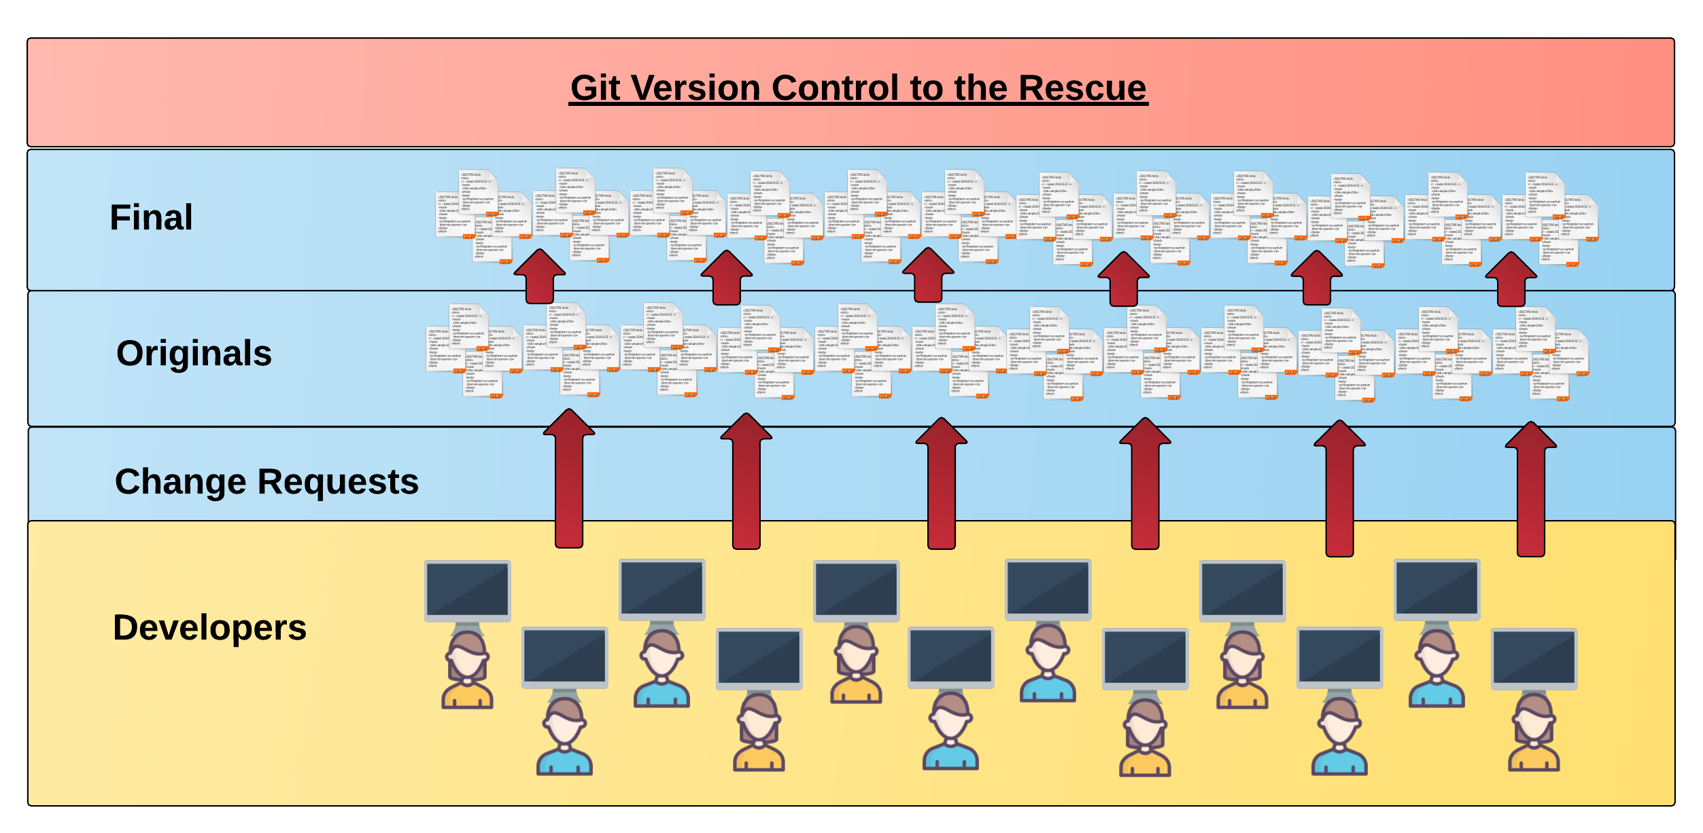
Collaborative Coding
Modern web development is highly collaborative.
Teams are often extremely large and separated across the country — or planet.
Apps sometimes comprise hundreds or even thousands of files.

Slide 14
The Team’s Task
Task: Make a list of creative works you’ve written in the past
Programming Team:
Maya Angelou
Anne Sexton
Gil Scott Heron

Slide 15

Maya & Gil make their edits
Programming Away…
Maya’s Version
Programming Away…
Gil’s Version

Slide 16
Different Solutions
<ul>
<li>On the Pulse of Morning</li> <li>I Know Why the Caged Bird Sings</li> <li>And Still I Rise</li>
</ul>
Different
<ul>
<li>Free Will</li> <li>Pieces of a Man</li> <li>The Revolution will not be Televised</li>
</ul>

Slide 17
Resolution
<ul>
<li>On the Pulse of Morning</li> <li>I Know Why the Caged Bird Sings</li> <li>And Still I Rise</li>
</ul>
“Let’s settle on this…”
<ul>
<li>Poems</li> <li>Albums</li> <li>Songs</li>
</ul>
<ul>
<li>Free Will</li> <li>Pieces of a Man</li> <li>The Revolution will not be Televised</li>
</ul>

Slide 18
Anne writes her own stuff…
<ul>
<li>The Double Image</li> <li>Heart’s Needle</li> <li>Baby Picture</li>
</ul>

Slide 19
Anne overwrites work of her teammates…
Delete. Delete. Delete. Delete.
Delete. Delete
<ul>
<li>Poems</li> <li>Albums</li> <li>Songs</li>
</ul>
<ul>
<li>The Double Image</li> <li>45 Mercy Street</li> <li>The Road Back</li>
</ul>

Slide 20
The Group Project
Lesson:
You should use Version Control.
….and watch your teammates’ work
Today we fret and pull on wheels, ignore our regular loss of time…
…or maybe we should just use git

Slide 21
Version Control
Git Version Control: Provides a organized system for managing code for when multiple developers work on a project
at the same time.
The Benefits of Git:
A process for resolving conflicts in code.
Version History.

Slide 22
The Group Project
Master Branch
‘Branch’ = personal copy
Personal branch
Maya’s branch
Anne’s branch
Gil’s branch

Slide 23
The team goes to work
<ul>
<li>On the Pulse of Morning</li> <li>I Know Why the Caged Bird Sings</li> <li>And Still I Rise</li>
</ul>
<ul>
<li>Free Will</li> <li>Pieces of a Man</li> <li>The Revolution will not be Televised</li>
</ul>

Slide 24
Maya pushes first
Master Copy
1
Maya pushes (uploads) her code changes into the main branch.
No code conflicts.
Maya’s Branch

Slide 25
Gil’s edits are ready
Rule: pull first, then push your changes
Ok

Slide 26
Gil pulls latest changes
Master Copy
1
Gil’s Branch

Slide 27
Gil conflicts with master branch
Master Branch
1
<li>On the Pulse of Morning</li> <li>I Know Why the Caged Bird Sings</li> <li>And Still I Rise</li>
<li>On the Pulse of Morning</li> <li>I Know Why the Caged Bird Sings</li> <li>And Still I Rise</li>
Git sees a conflict.

Slide 28
Kobe resolves
<ul>
<li>Poems</li> <li>Albums</li> <li>Songs</li>
</ul>
<li>On the Pulse of Morning</li> <li>I Know Why the Caged Bird Sings</li> <li>And Still I Rise</li>
<li>On the Pulse of Morning</li> <li>I Know Why the Caged Bird Sings</li> <li>And Still I Rise</li>
Gil’s Branch

Slide 29
Gil fixes and pushes
Master Branch
1
2
Gil pushes (uploads) his revision the main branch.
No code conflicts.
<ul>
<li>Poems</li> <li>Albums</li> <li>Songs</li>
</ul>
Gil’s Branch

Slide 30
Anne starts her work
Rule: pull first, then push your changes
look into my face and you will know that crimes dropped upon me
as from a high building…
…by which I mean, I broke the rules.

Slide 31
Anne pushes
Master Branch
1
2
3
Anne dude pushes (uploads) her revision the main branch. No code conflicts.
Not what we want.
<ul>
<li>The Double Image</li> <li>Heart’s Needle</li> <li>Baby Picture</li>
</ul>
Anne’s Branch

Slide 32
If Annehad made a pull first…
Conflict!
<ul>
<li>The Double Image</li> <li>Heart’s Needle</li> <li>Baby Picture</li>
</ul>
<ul>
<li>Poems</li> <li>Albums</li> <li>Songs</li>
</ul>

Slide 33
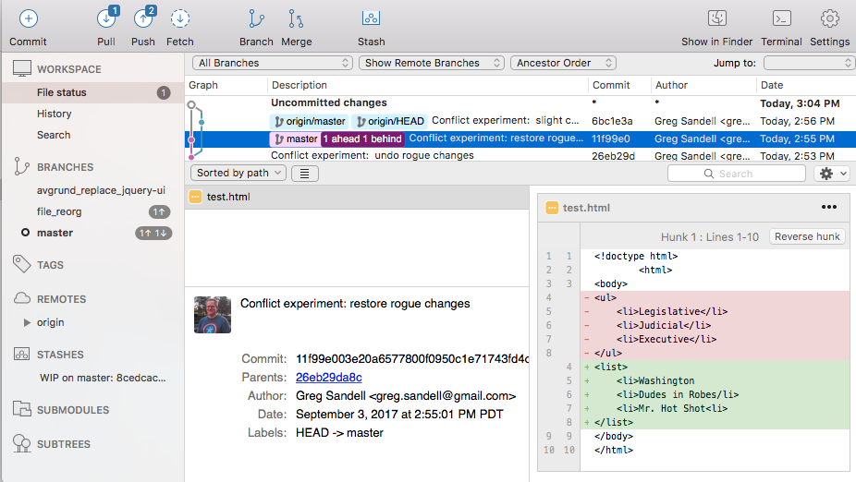
The overwritten work is discovered

Slide 34
Roll Back
Main Branch
1
2
3
4
Maya rolls back the code to an earlier version.
Anne’s Branch

Slide 35
The Group Project
Lesson:
You should use Version Control!

Slide 36
Quick Activity!
Suggested Time: 3 min
Turn to your neighbor, and have one of you explain to the other:
The concept of version control.
Then the other should explain:
Two of the key advantages to using a version control system.

Slide 37

So… What’s this GitHub?
GitHub is a Web-Based hosting service to store code online.
It allows developers to pull (download) code or push (upload) code to the same repository (directory).
It also allows developers to view histories of code changes and to track issues.

Slide 38

Pushing and Pulling to GitHub
1
2
3
4
GitHub Branch
Pull Code
Push Code
Pull Code
Pull Code
Push Code
Pull Code
Push Code

Slide 39
Get Started with Git

Slide 40
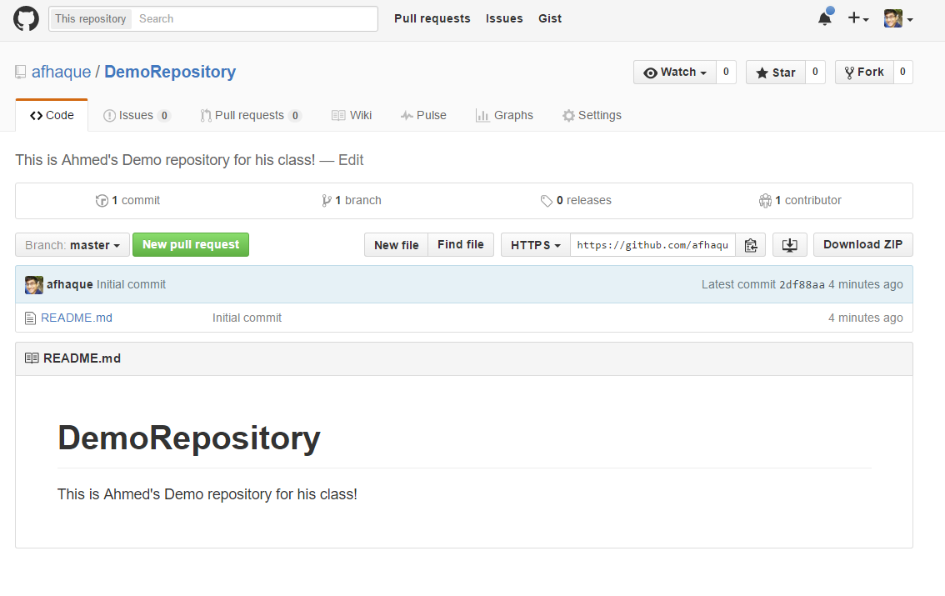
Instructor Git Demo!

Slide 41
Basic Git Commands
At its most basic, these are the five git commands to get started:
git clone
git add
git commit
git push
git pull

Slide 42
Basic Git Commands
At its most basic, these are the five git commands to get started:
git clone – copies an entire repo (to begin).
git add – adds a file for inclusion in Git.
git commit – notes a change to the local repo.
git push – sends changes to hosting service.
git pull – downloads freshest version of repo.

Slide 43
> YOUR TURN!
Activity: Git Add, Commit, Push | Suggested Time: 20 min
Assignment:
Using GitHub and the Command Line:
Create a new public GitHub repository and name it whatever you like. Be sure to check the box for “initialize this repository with a README.”
Next, clone the repo to your local directory.
Then create an HTML file inside the local directory.
Add, Commit, and Push the code to GitHub.
Bonus:
Find a partner in class, and fork their repository to your own GitHub account. Clone this forked repository to your local directory.
Add, Commit, and Push the code back to your forked copy.
Finally, submit a pull request to send your changes to your partner’s repo.

Slide 44

Still a Bit Lost? Never Worry!
Follow this handy Guide!
Practice a few times on your own before our next class.

Slide 45
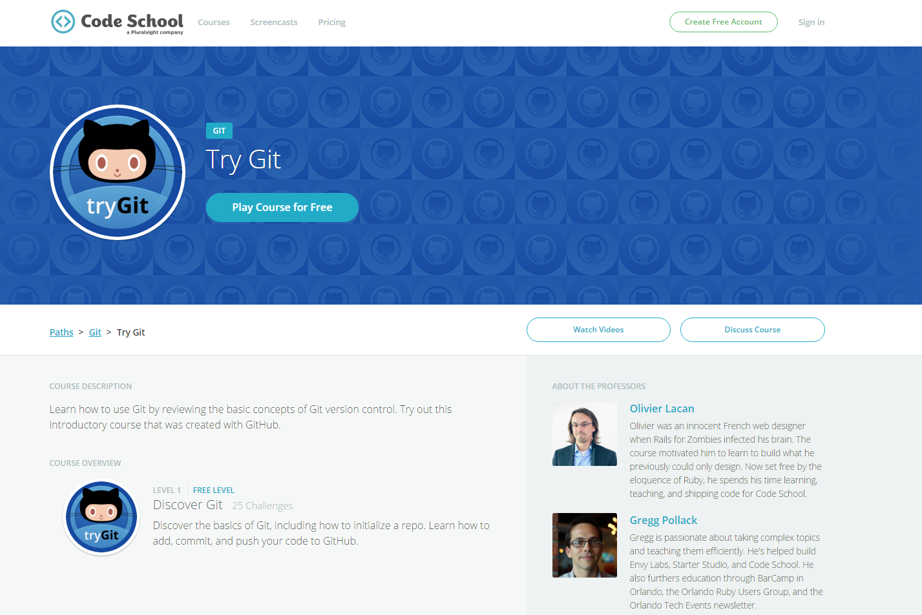
If You’re Still Lost… Here’s a (Free) Course
https://www.codeschool.com/courses/try-git

Slide 46
HTML Round 2

Slide 47
HTML Syntax (Basic)
Content
<h1>
This is Mah House
</h1>
Opening Tag
Closing Tag

Slide 48
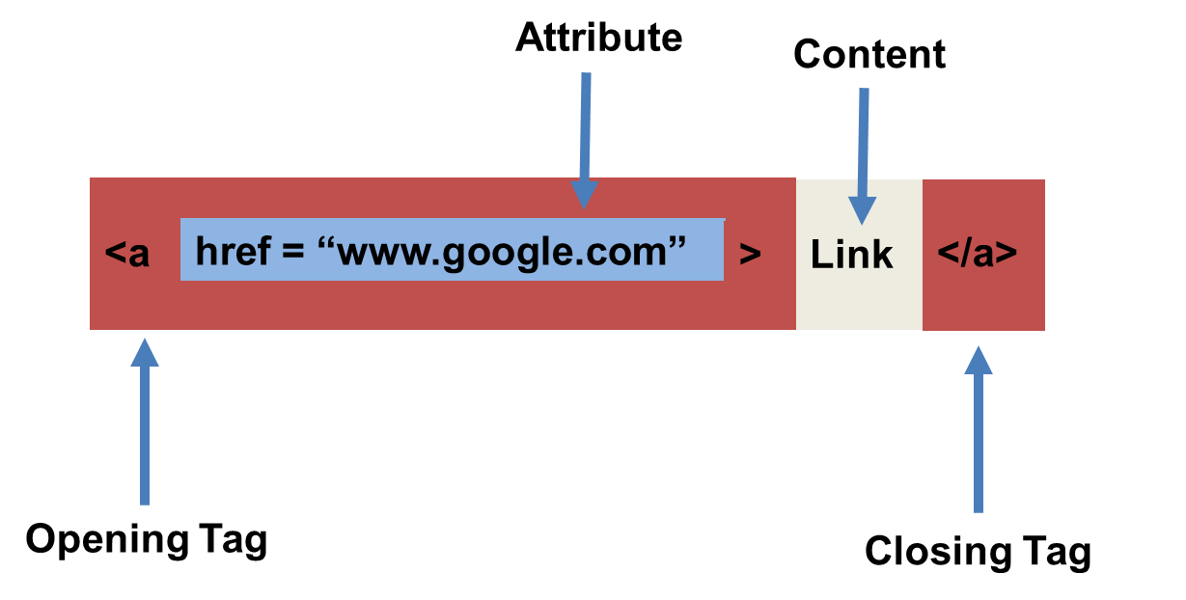
HTML Syntax (with Attribute)

Slide 49
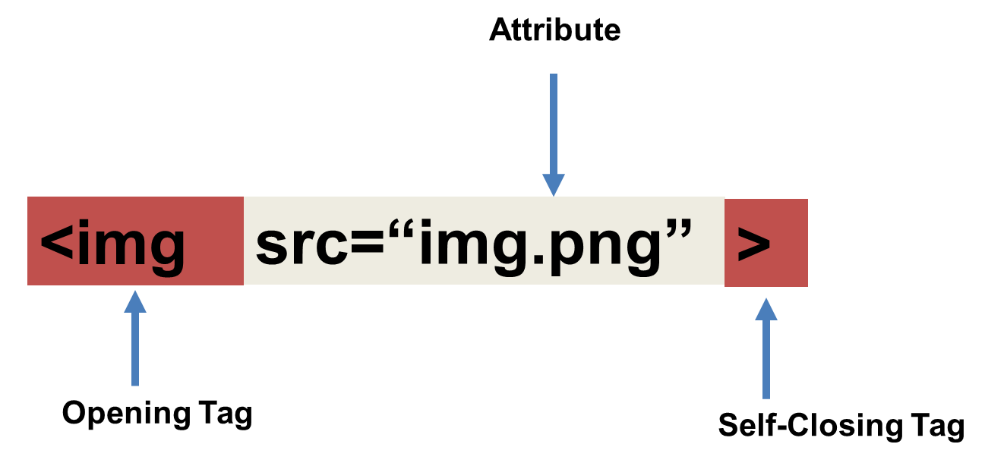
Tricky Tags (Self-Closing)

Slide 50
Important Common Tags
Headings:
<h1> </h1> - Heading 1 (Largest Heading)
<h2> </h2> - Heading 2 (Next Largest Heading)
<h3> </h3> - Heading 3
…
Containers:
<html> </html> - Wraps the entire page
<head> </head> - Wraps the header of the page
<body> </body> - Wraps the main content
<div> </div> - Logical Container ***
<p> </p> - Wraps individual Paragraphs
Others:
<strong> (bold), <em> (emphasis)
<img> (images), <a href> (links), <li> (list items) , <title> (title), <br> (line break), <table> (tables), <!-- --> (comments)

Slide 51
Less Common Tags
All HTML Tags are listed here: http://www.w3schools.com/tags/
Don’t try to memorize them! Simply refer back to documentation as needed.
Other tags:
<video> for Videos
<audio> for Audio files
<embed> for Embedded files
<code> for including computer code
<header> for headers
<nav> for navigation bars
<footer> for footers

Slide 52
HTML for Forms
Common UI (User Interface) Form Elements:
<form> - Creates a form section in HTML
<input> - Input boxes
<label> - Labels for boxes
<button> - Button
<textarea> - Large textbox

Slide 53
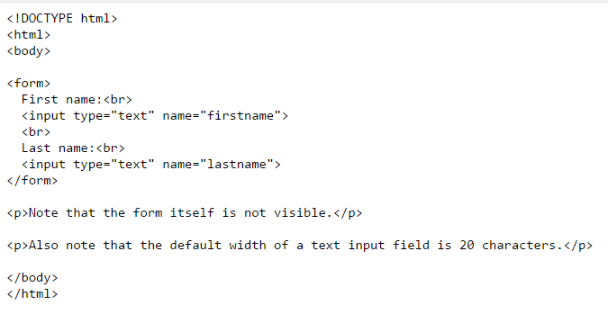
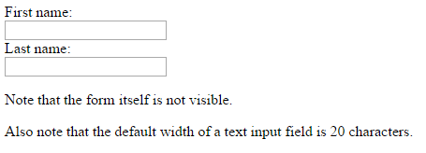
HTML for Forms

Slide 54
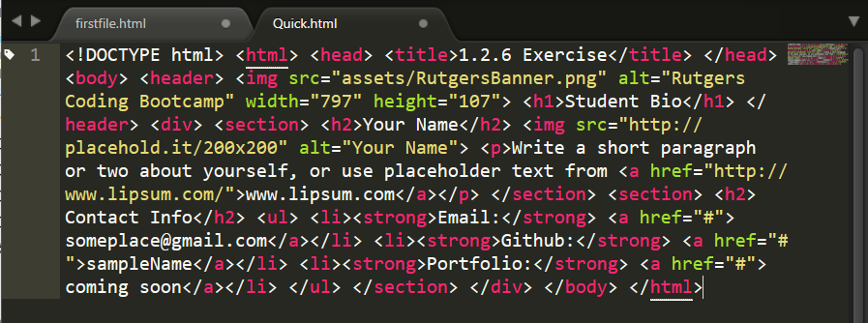
On Ugly HTML
Don’t do this… Use proper indentation and sectioning.
Readable code is easier to maintain.
Invest time to get better about this now. It will pay dividends!

Slide 55
> YOUR TURN!
Activity: 1-HTML_Git | Suggested Time: 20 min
Assignment
In this activity, you’ll create a student bio using HTML. You will then add, commit, and push your completed HTML to GitHub for the world to see.
Additional instructions, sent via Slack.

Slide 56
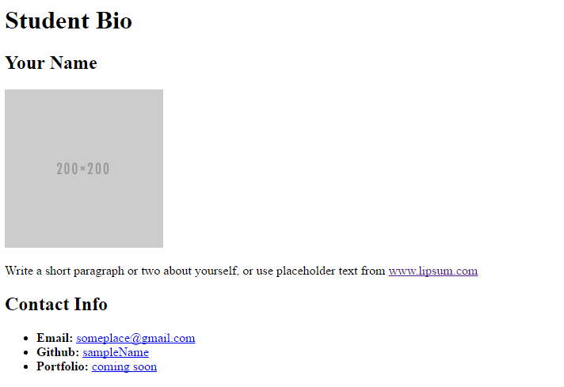
> YOUR TURN!

Slide 57
CSS Stylin’

Slide 58


HTML / CSS Definitions (*yawn* unimportant)
HTML: Hypertext Markup Language – (Content)
CSS: Cascading Style Sheets – (Appearance)
HTML/CSS are the “languages of the web.” Together they define both the content and the aesthetics of a webpage – handling everything from the layouts, colors, fonts and content placement. (JavaScript is the third – handling logic, animation, etc.)

Slide 59


HTML / CSS Analogy
HTML Alone
Like writing papers in “Notepad.”
Can only write unformatted text.
HTML / CSS
Like writing papers in Microsoft Word.
Can format text, page settings, alignment, etc. based on “highlighting” and menu options.

Slide 60
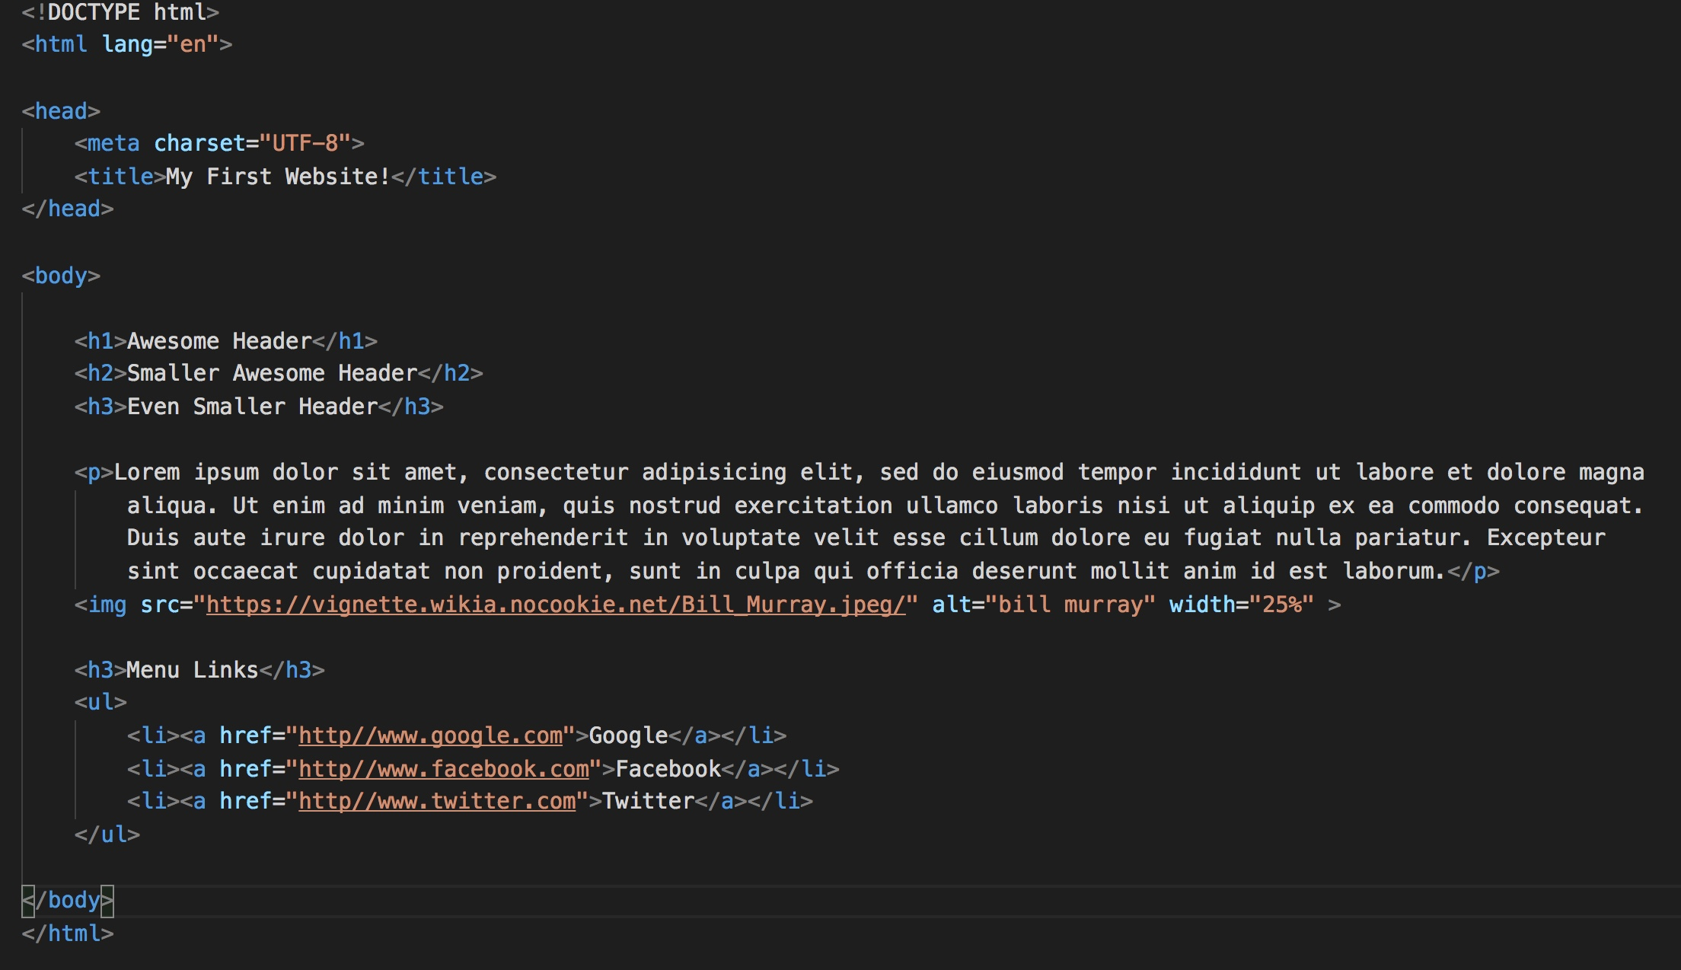
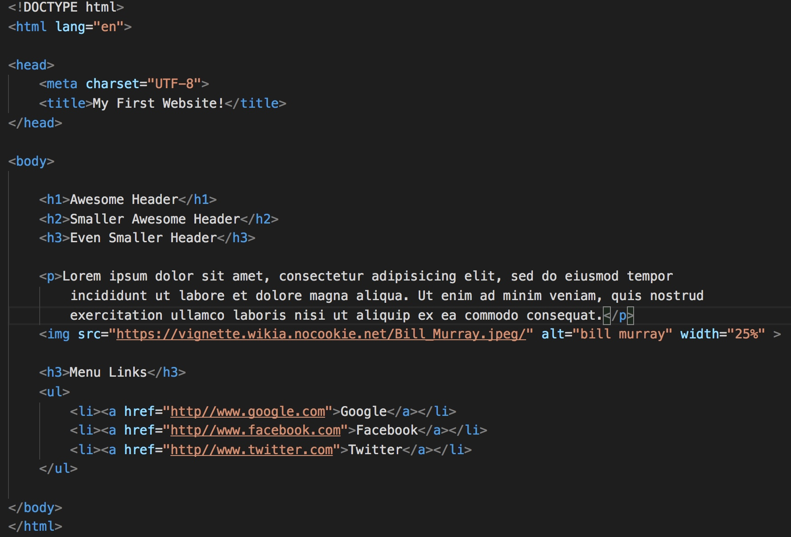
Basic HTML Page

Slide 61

Basic HTML Page - Result

Slide 62
Basic HTML Page - Result
Hella Boring…

Slide 63
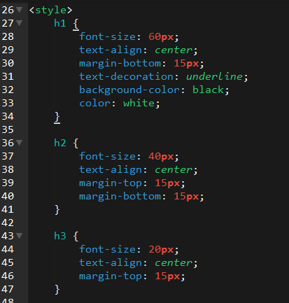
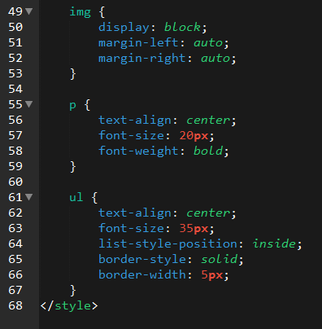
Enter CSS

Slide 64

Enter CSS - Result

Slide 65

CSS Syntax
CSS works by hooking onto selectors added into HTML using classes and identifiers.
Once hooked, we apply styles to those HTML elements using CSS.

Slide 66
CSS Example
In the below example the “Header” would be turned blue and MUCH larger because of the CSS.
We can incorporate an element’s class or ID to apply a CSS style to a particular part of the document.
Just remember to include the necessary symbol before the CSS: “.” for class, “#” for ID.
Example (HTML):
<p class=“bigBlue”>Header</p>
Example (CSS):
.bigBlue
{
font-size: 100px;
color: blue;
}

Slide 67
Key CSS Attributes
Font / Color:
color: Sets color of text.
font-size: Sets size of the font.
font-style: Sets italics.
font-weight: Sets bold.
Alignment / Spacing:
padding (top/right/bottom/left): Adds space between element and its own border.
margin (top/right/bottom/left): Adds space between element and surrounding elements.
float: Forces elements to the sides, centers, or tops.
Background:
background-color: sets background color.
background-image: sets background image.

Slide 68
Powerful Duo
Believe it or not, HTML / CSS is all you need
to develop a vivid, full-blown website.

Slide 69
INSTRUCTOR DEMO
Instructor: Demo
(quickexample_internalcss.html | 2-BasicCSS)

Slide 70
> YOUR TURN!
Activity: 3-HTML_CSS_Layout | Suggested Time: 20 min
Assignment
In this activity, you’ll upgrade your previous HTML bio-page using CSS style rules. Once you’re done, commit and push up your changes to GitHub.
We’ll send you additional instructions via Slack.

Slide 71
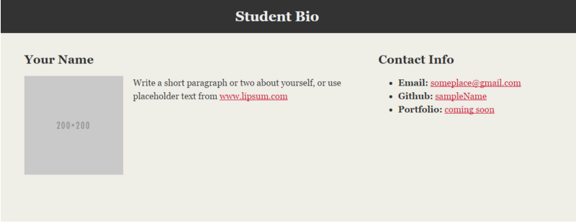
> YOUR TURN!

Slide 72
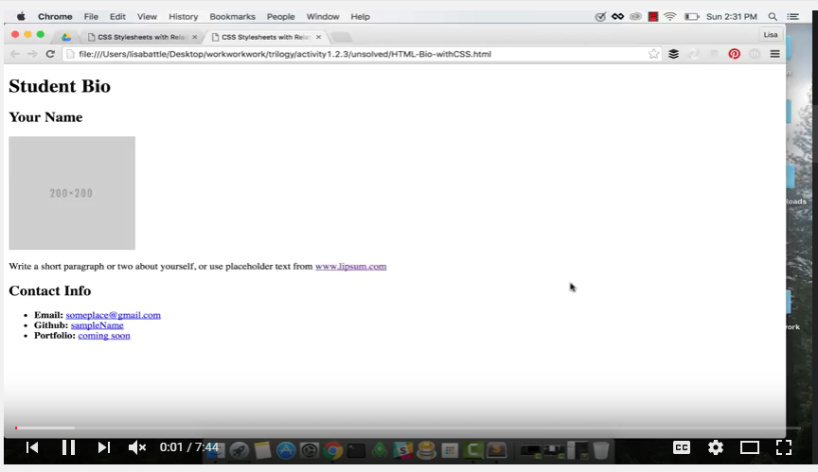
Video Walkthrough!!
https://www.youtube.com/watch?v=kMBinXTCrXI&list=PLgJ8UgkiorCnMLsUevoQRxH8t9bt7ne14&index=2

Slide 73

Still a Bit Confused?
Remember! We’ve got video guides for key activities like that last one.
If you feel like you are EVER falling behind, use those online walkthroughs to help catch back up. They are made to be easy to understand.
Still having trouble? Shoot your instructor or one of your TAs a message!
We are here to help you out in whatever way we can!

Slide 74
Recap + Questions

